Slide 1
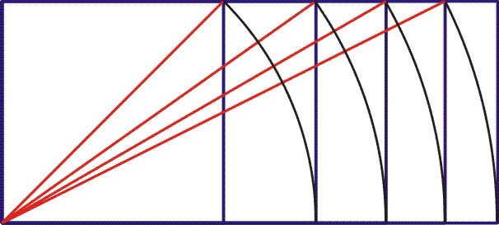
Square-Root Rectangle Symmetry
Page 57
Michael S. Schneider
www.constructingtheuniverse.com

Slide 2
Starting with the square,
the diagonal of each rectangle
becomes the long side of the next rectangle.
= 1
= 1.414…
< 1.5
= 1.732…
< 1.75
= 2
How far can you go?
Answer: How sharp is your pencil?
= 2.236…
< 2.25

Slide 3
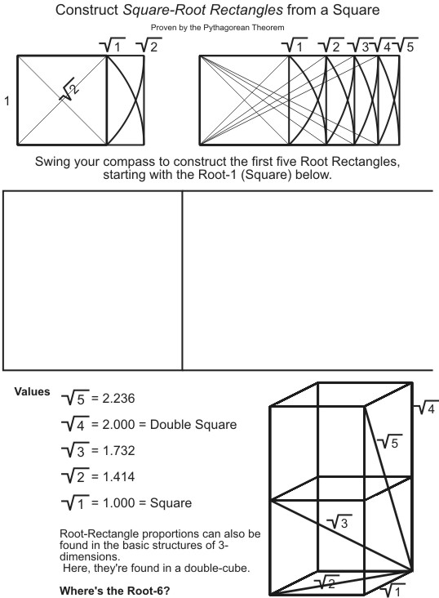
Page 58
Start with this extended square in your Reader
and construct (at least) the first five Root Rectangles.
You need not draw these diagonals.
Colors are nice.

Slide 4
Page 58
< 2.25
< 1.75
< 1.5

Slide 5
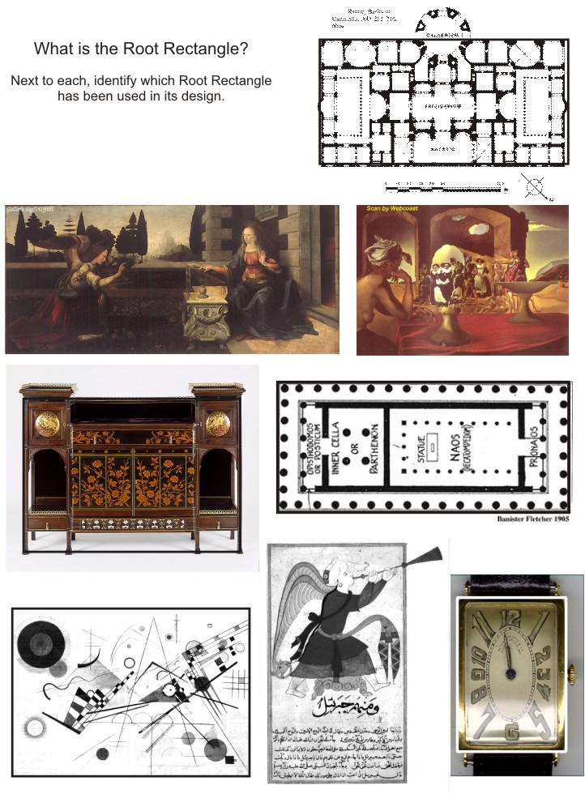
Page 60

Slide 6
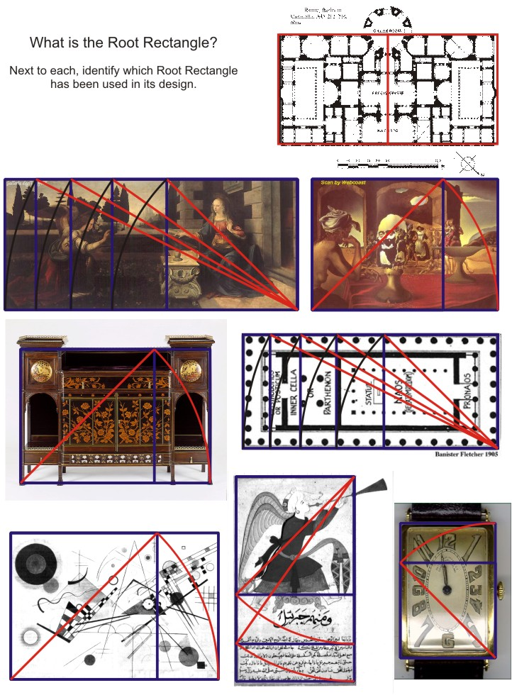
Page 60
Sqrt 4
Sqrt 5
Sqrt 2
Sqrt 2
Sqrt 5
Sqrt 3
Sqrt 2
Sqrt 2

Slide 7
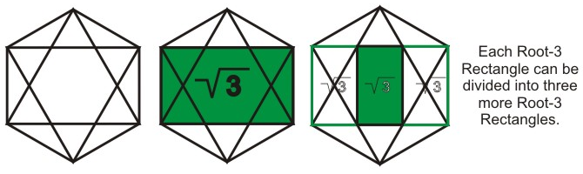

Page 59
A root-3 rectangle divides into
3 smaller versions of itself (root-3 rectangles)

Slide 8
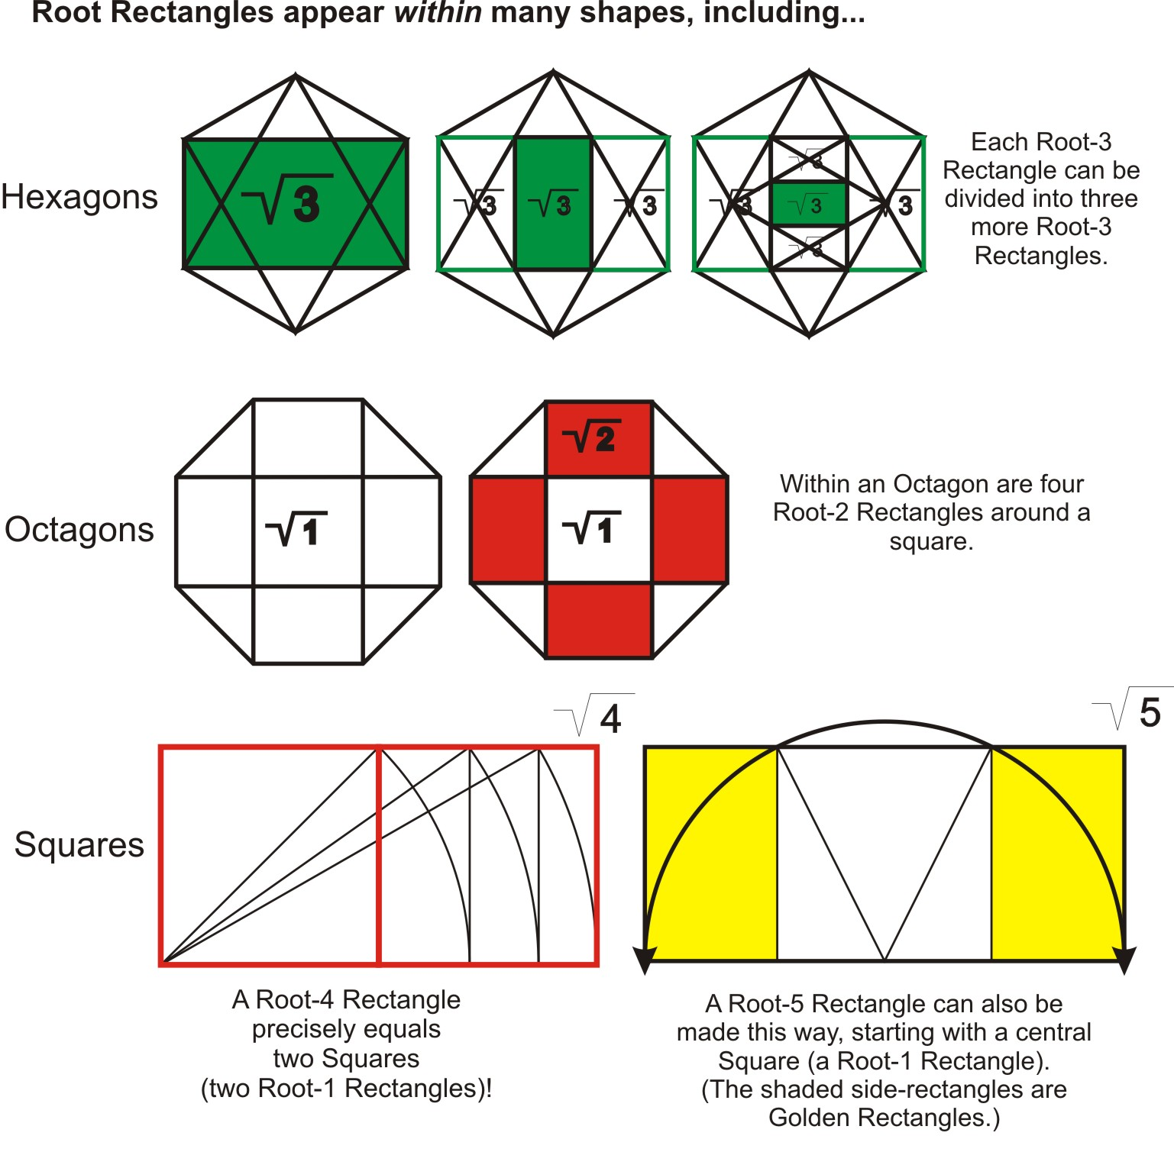
Page 59

Slide 9
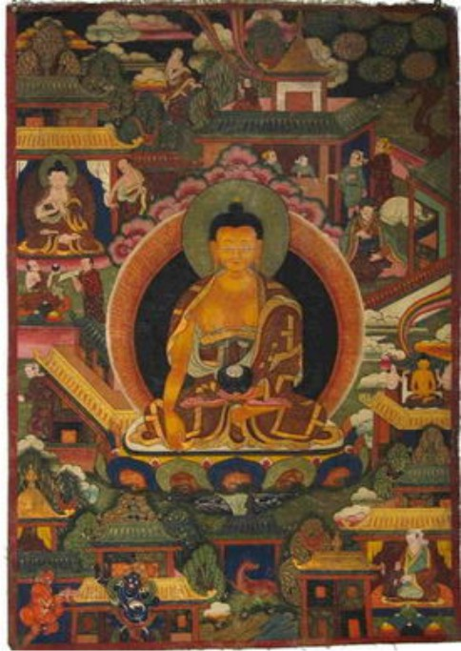
In this Root-2 rectangle
Buddha floats on a lotus.
We’re meant to visually feel his stability, but not to see its source

Slide 10
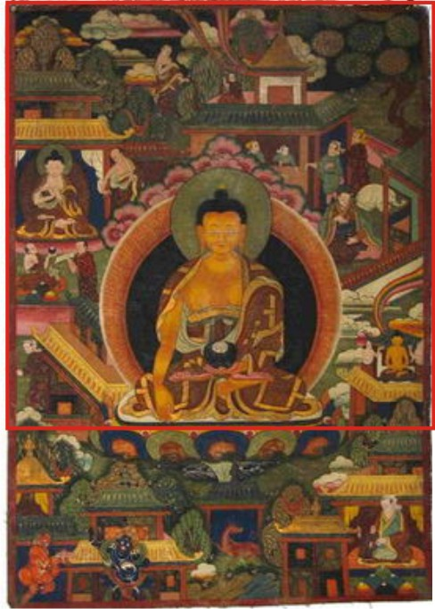
He rests upon the bottom of a square.
He neither floats up nor sinks down.

Slide 11
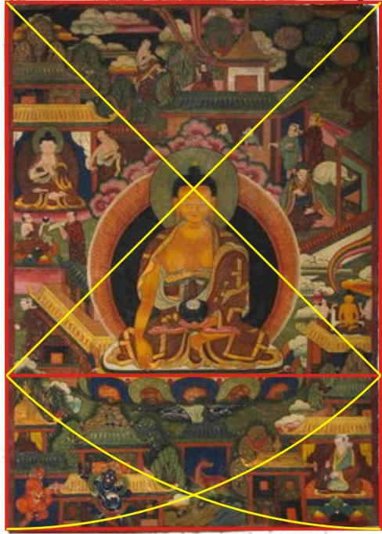
Every element of the composition of this painting comes from this basic framework.

Slide 12
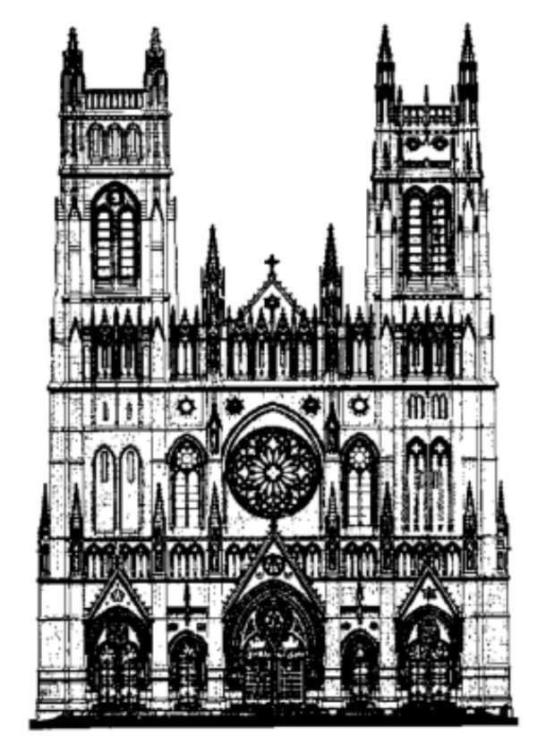

Slide 13
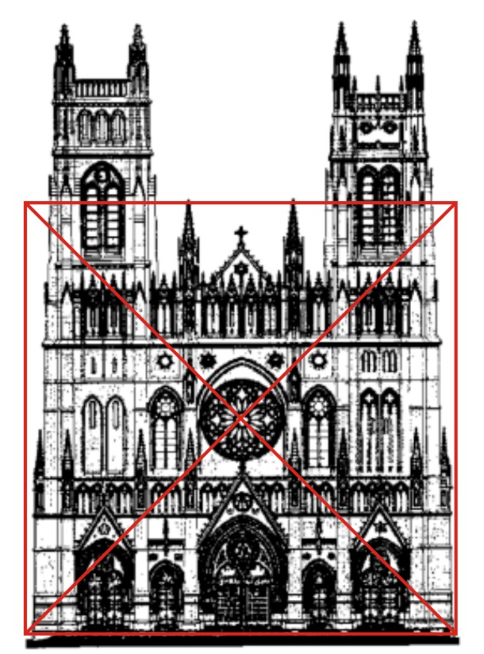

Slide 14
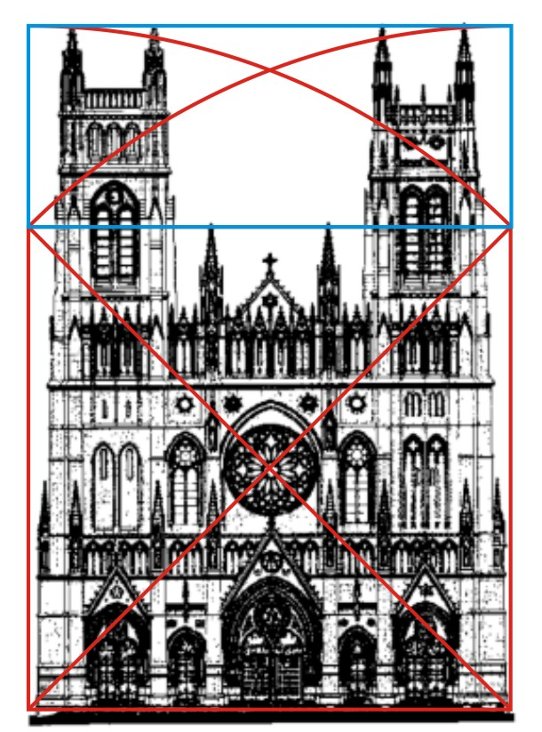

Slide 15
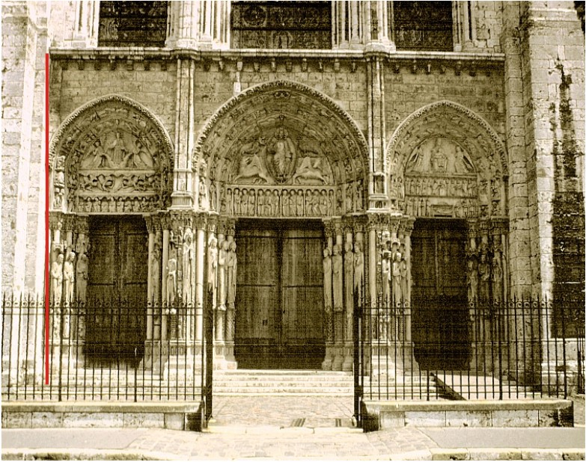
Chartres Cathedral

Slide 16
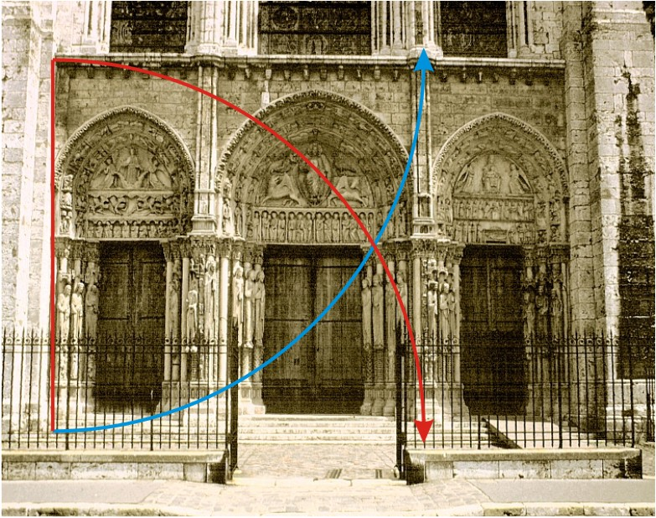

Slide 17
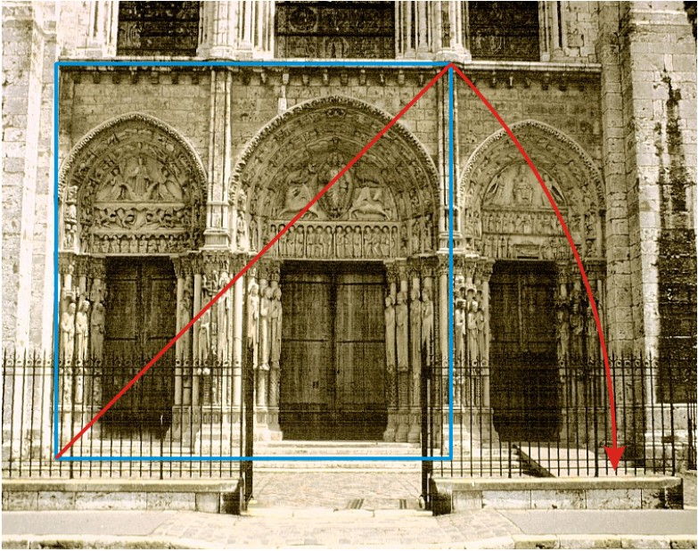

Slide 18
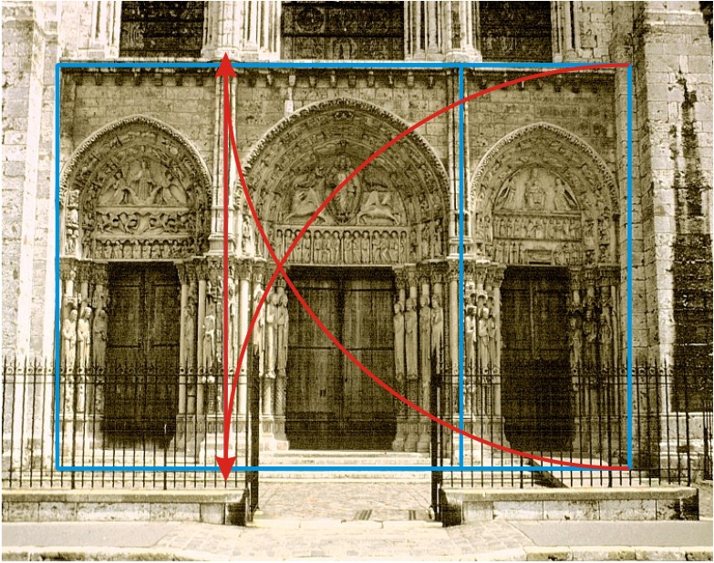

Slide 19
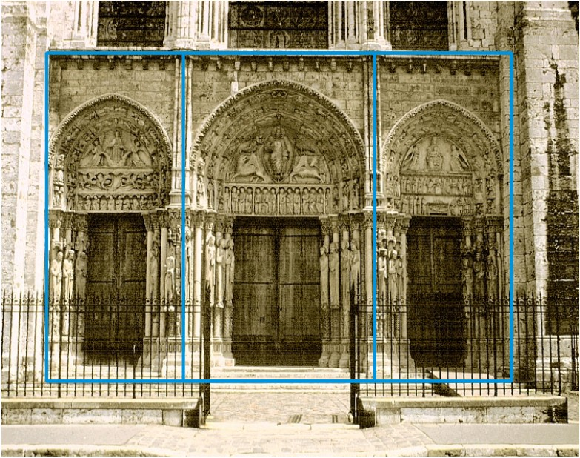
Overlapping Squares in a Root-2 Rectangle

Slide 20
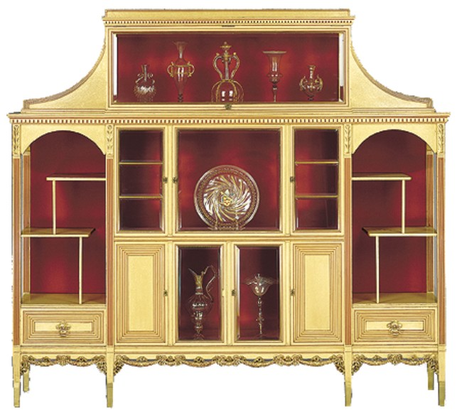
Herter Brothers Cabinet
Late 19th century

Slide 21

Begin with a Square.

Slide 22
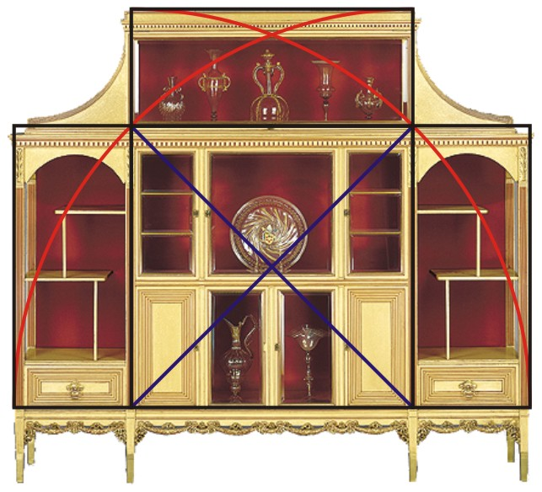
Use the square’s diagonals to swing arcs, making three overlapping Root-2 rectangles.

Slide 23
Filling in the corners with green squares makes the whole a large Root-2 rectangle.
All elements derive from this framework.

Slide 24
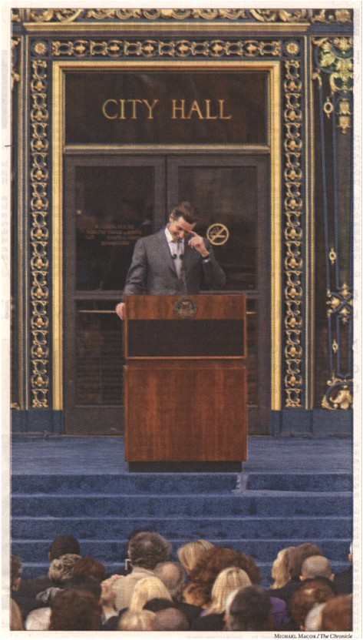
SF City Hall Entrance

Slide 25
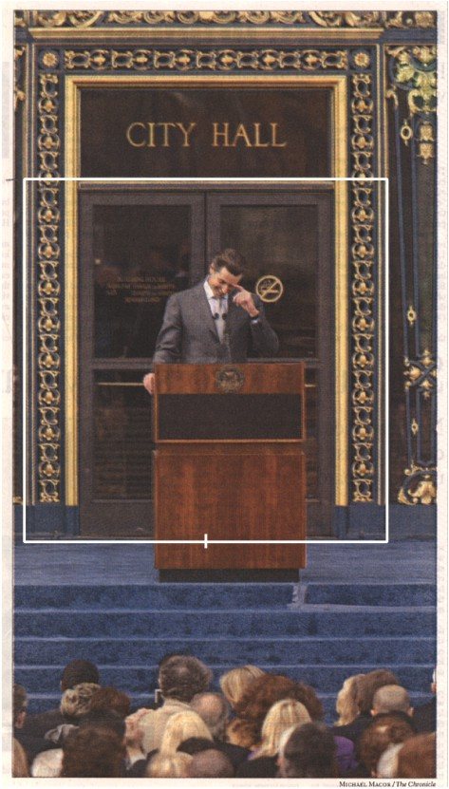

Slide 26
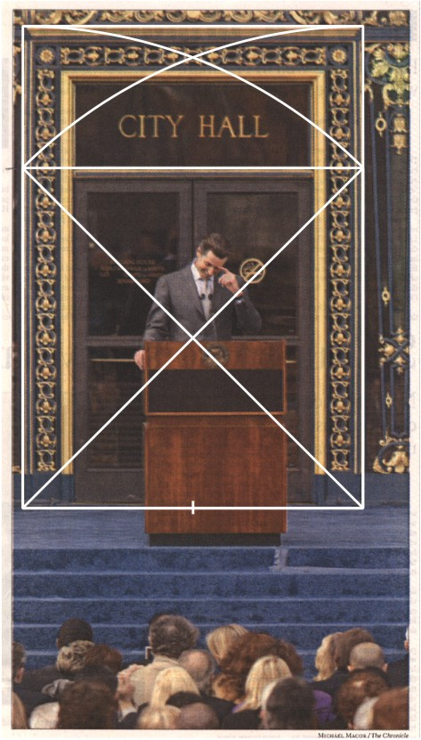

Slide 27
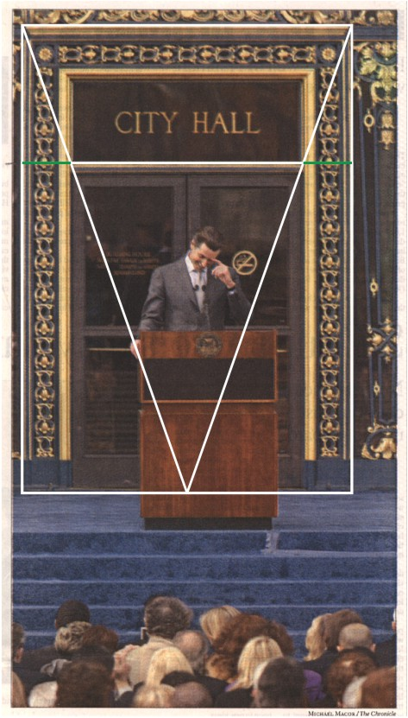

Slide 28
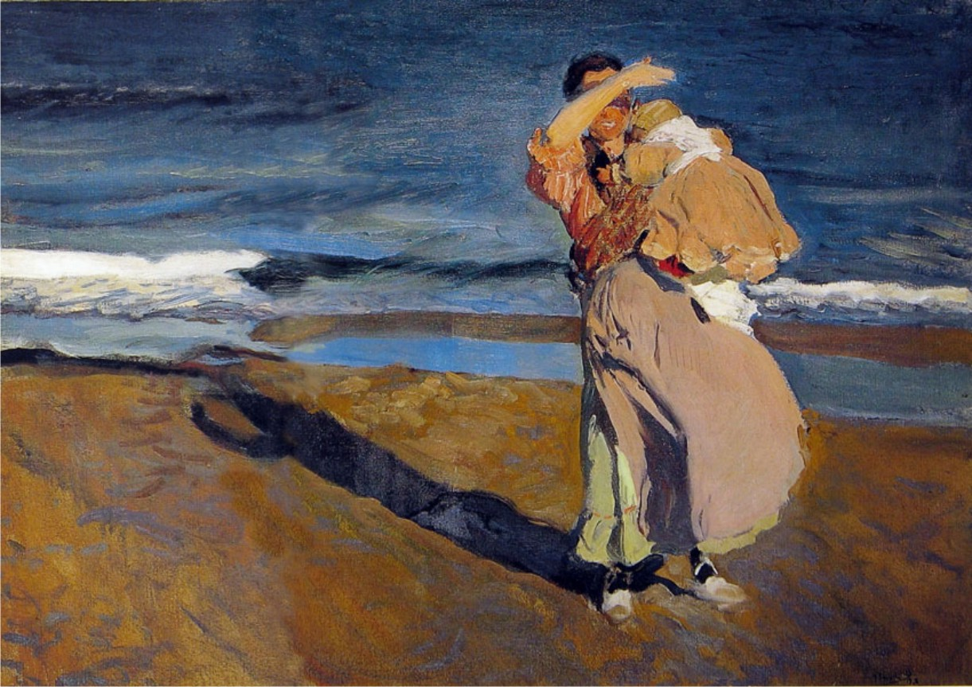
The Fisherwoman
Joaquin Sorolla y Bastida
1863-1923

Slide 29
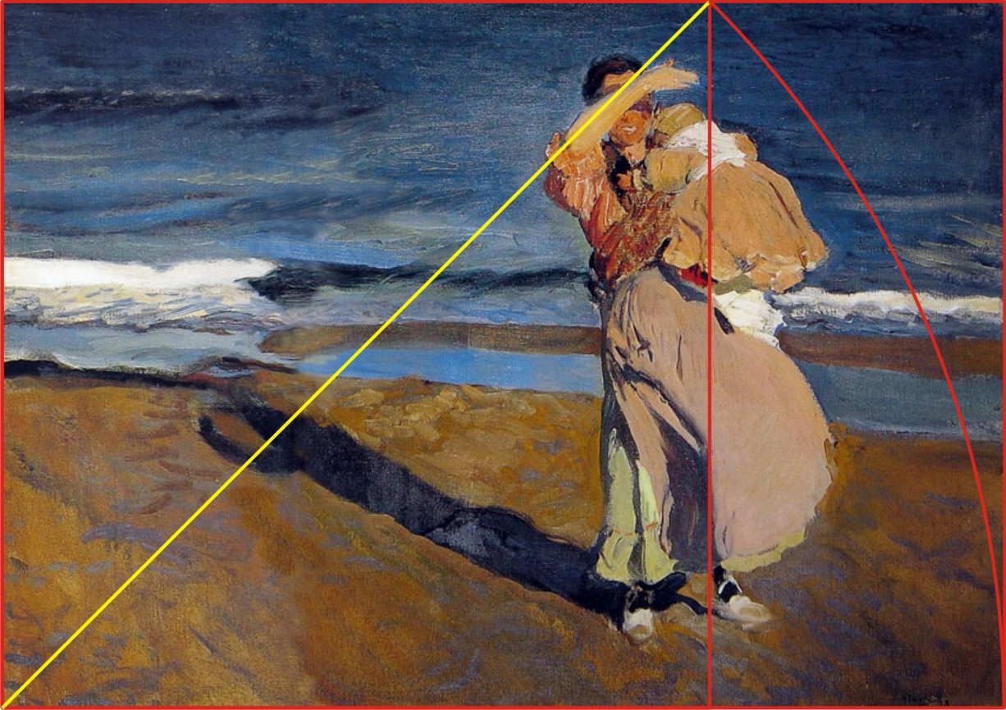

Slide 30
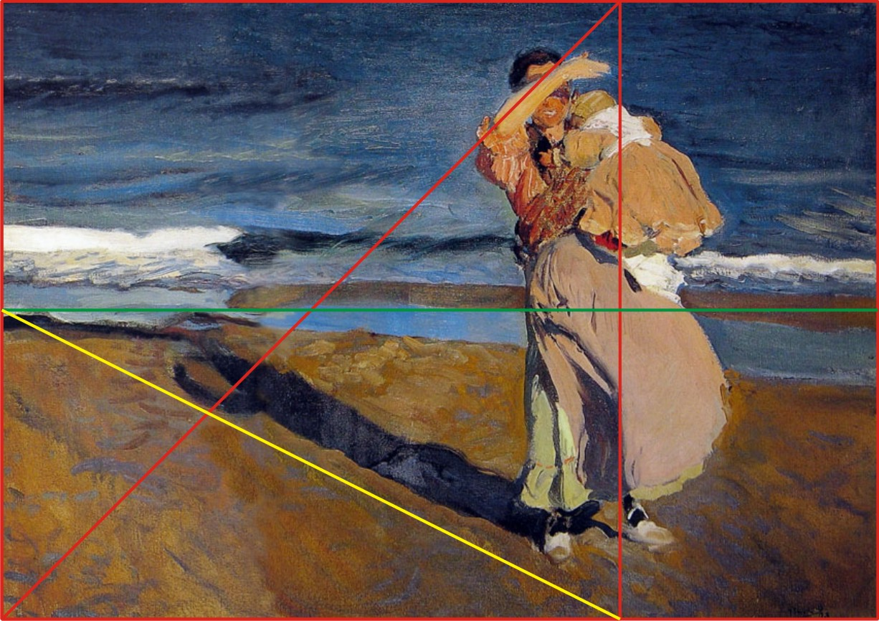

Slide 31
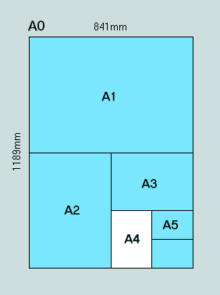
European “A” Paper
(Root 2 Rectangles, each half the size of the next larger)

Slide 32
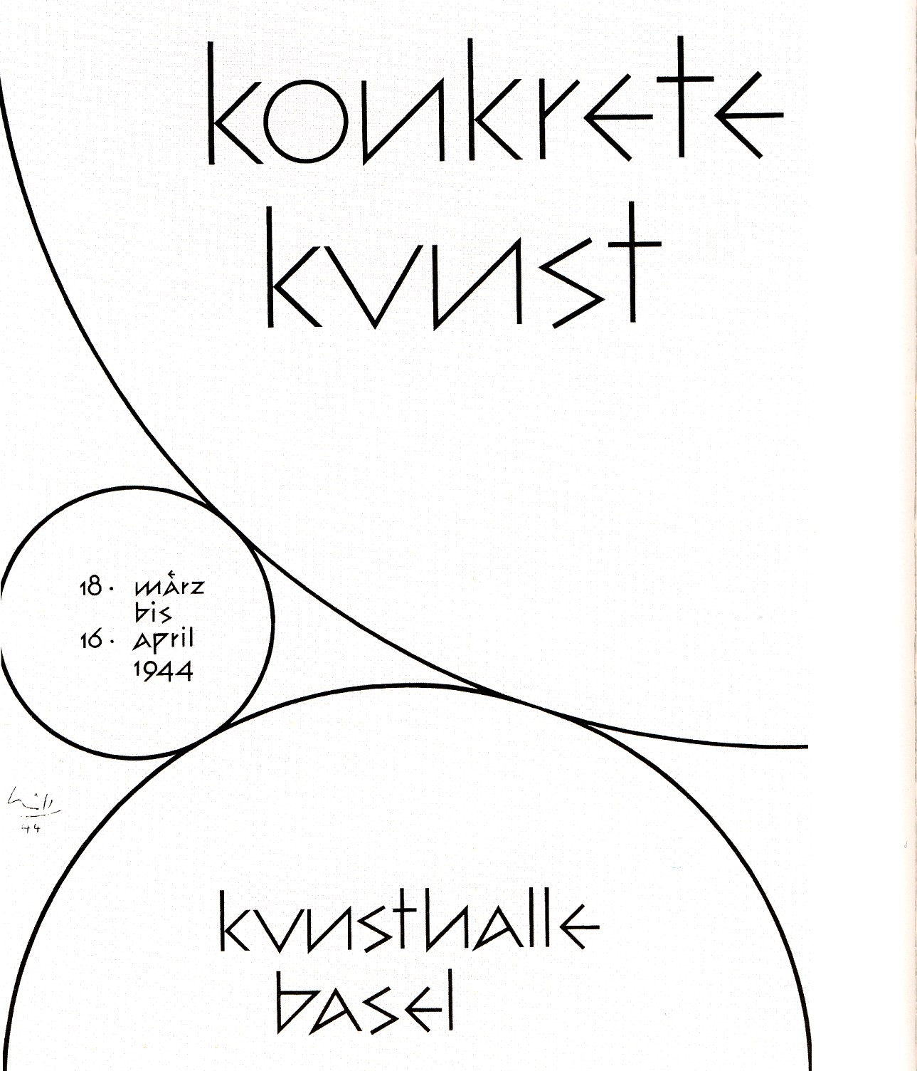
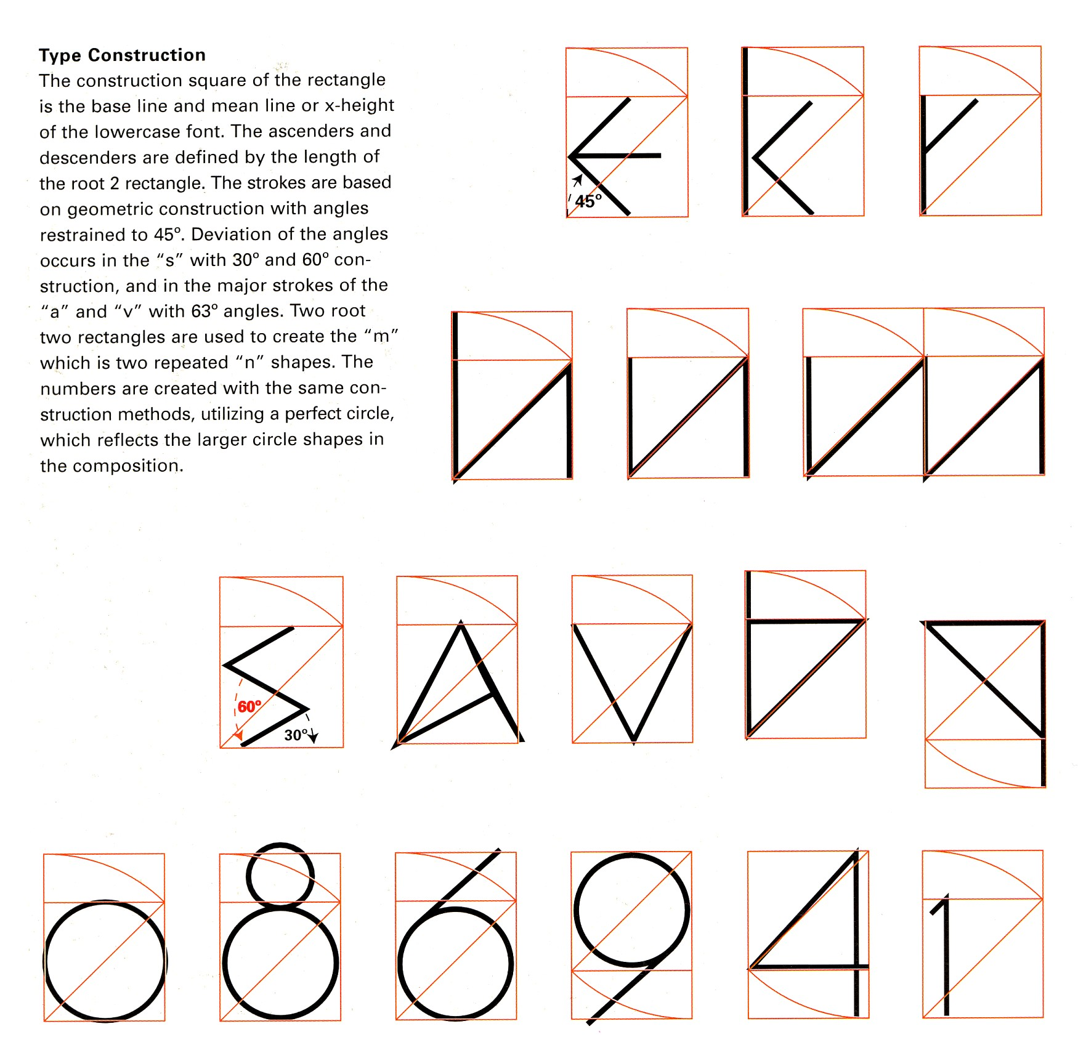
Page 63
Root 2 Rectangle
Type Construction
Each letter is based on the
same proportion as the whole poster.
This can be done using any Root Rectangle.

Slide 33
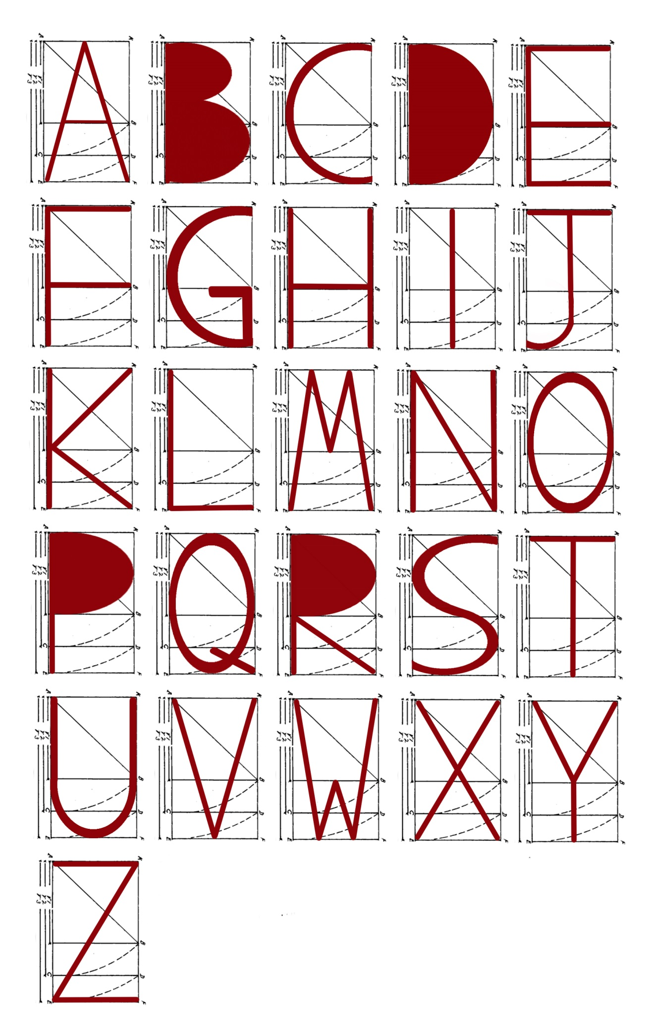
Page 64
Root-3 Rectangle Typography
Leecie Suyeda

Slide 34
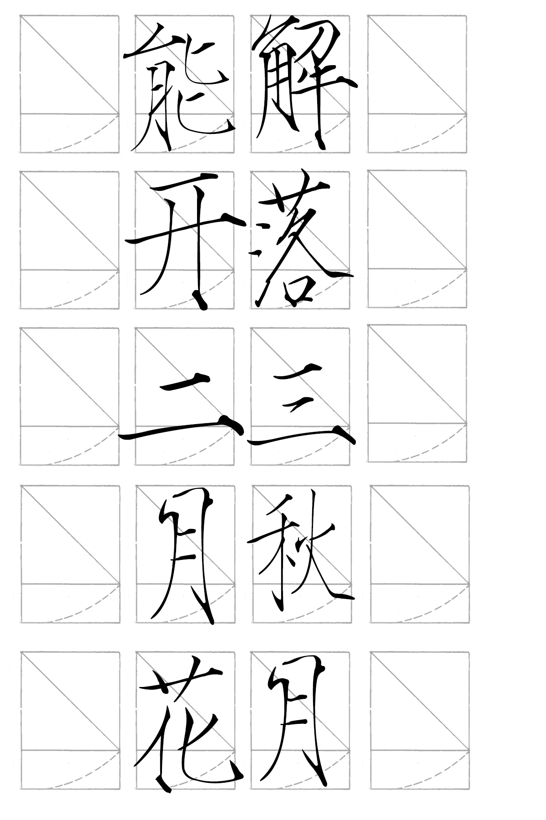

Slide 35


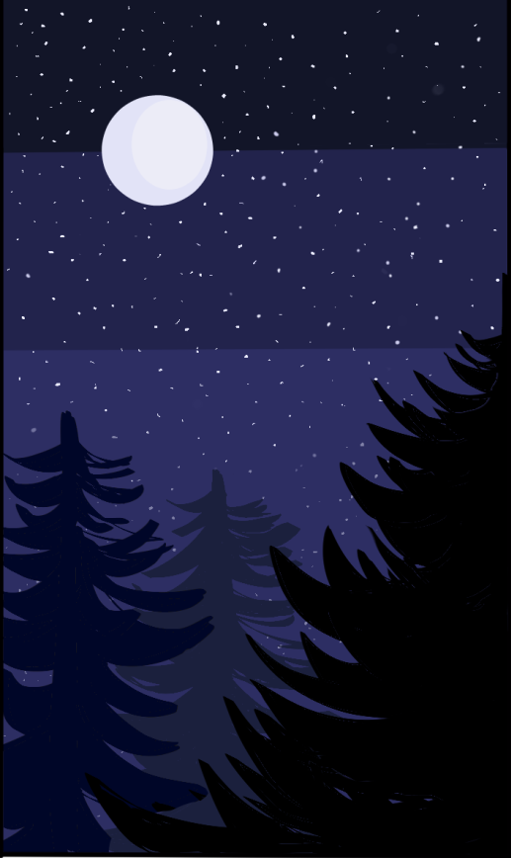

Slide 36

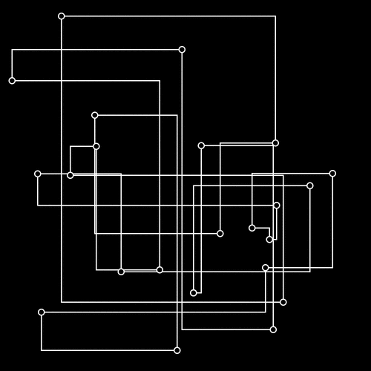
Due at the class after the Midterm exam.
Homework?

Slide 38
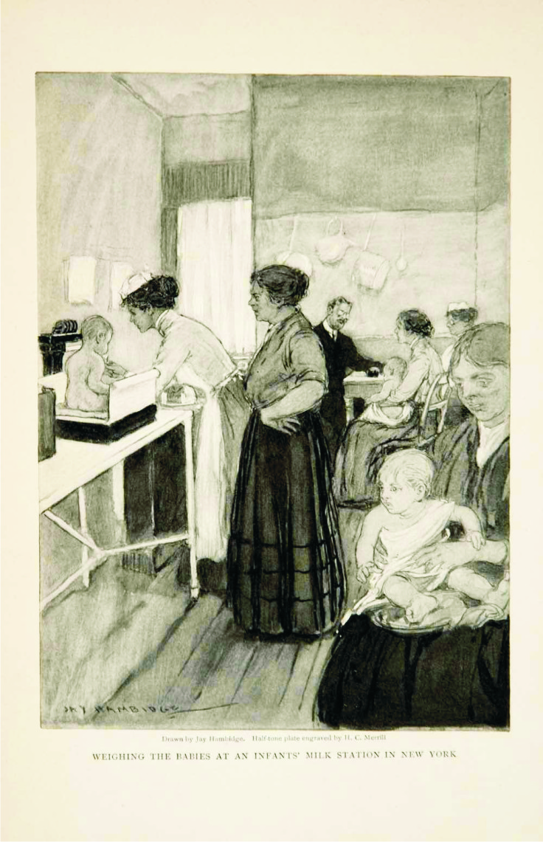
Page 62

Slide 39
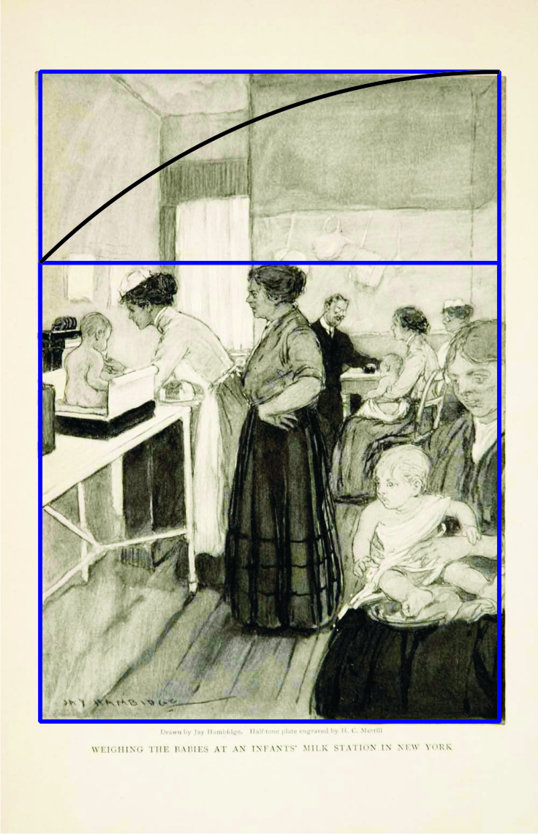
Page 62

Slide 40
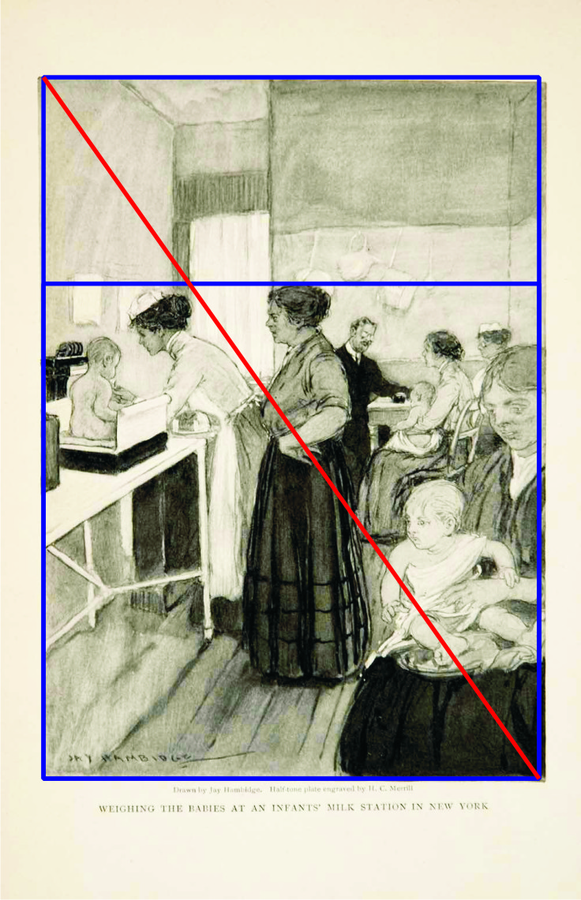
Page 62

Slide 41
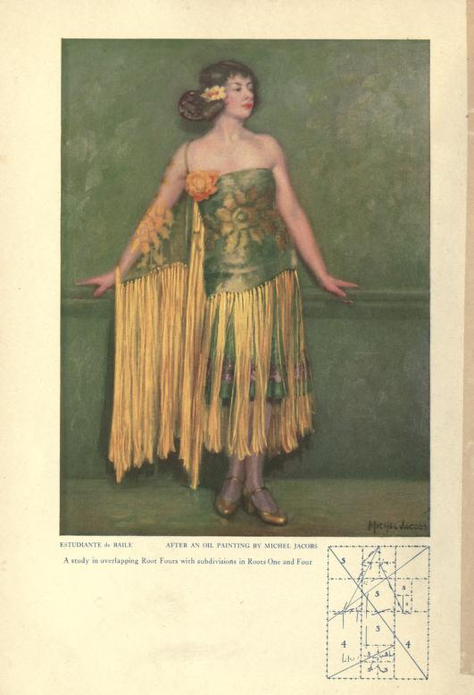
The Art of Compostion: A Simple Application of Dynamic Symmetry (1926) by Michel Jacobs (downloadable pdf)
https://archive.org/details/artofcomposition00jacouoft

Slide 42
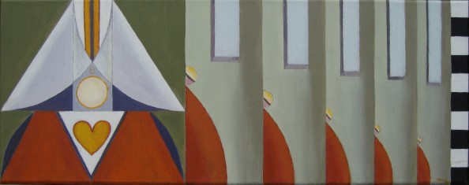
KIRSTEN HØST
http://www.hoestart.com/

Slide 43
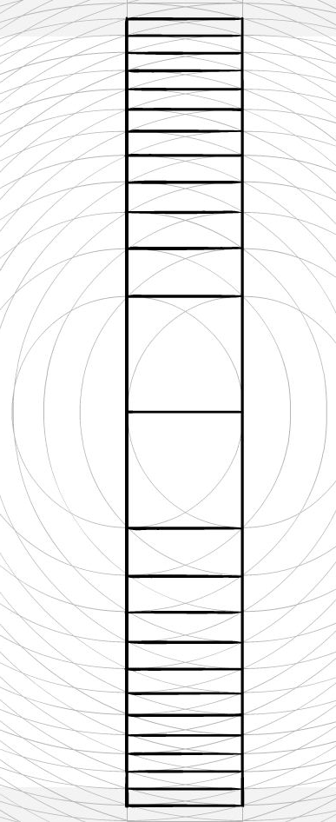
How far can you go?

Slide 44
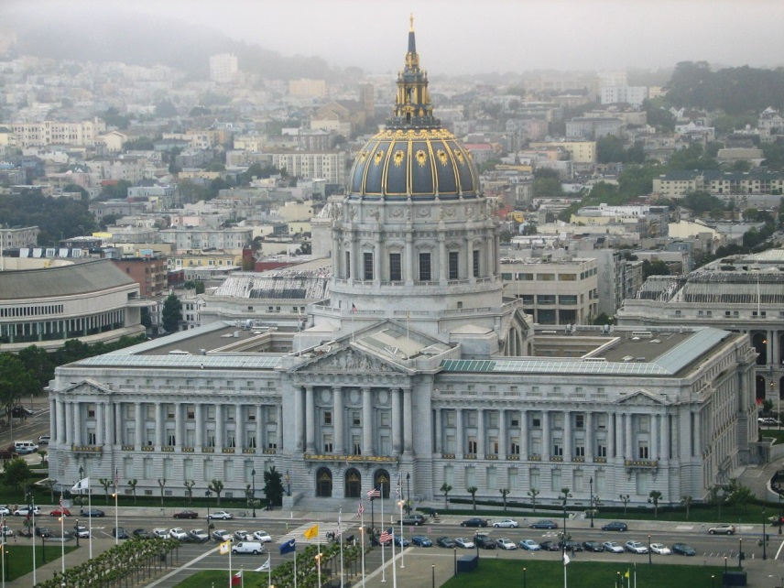
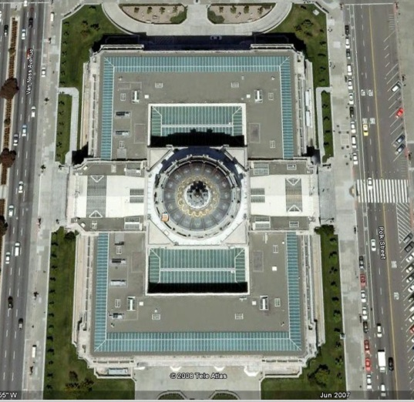
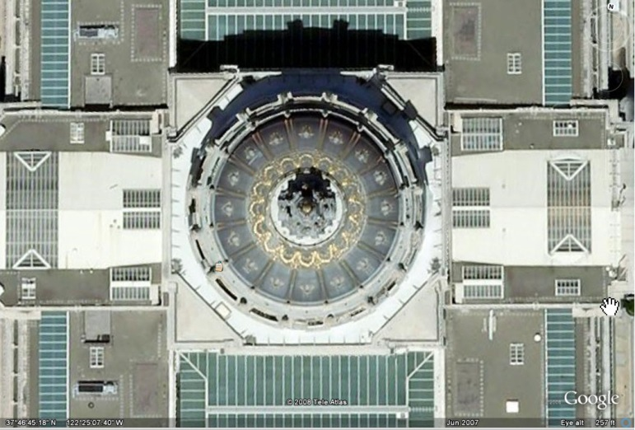
SF City Hall
octagon

Slide 45
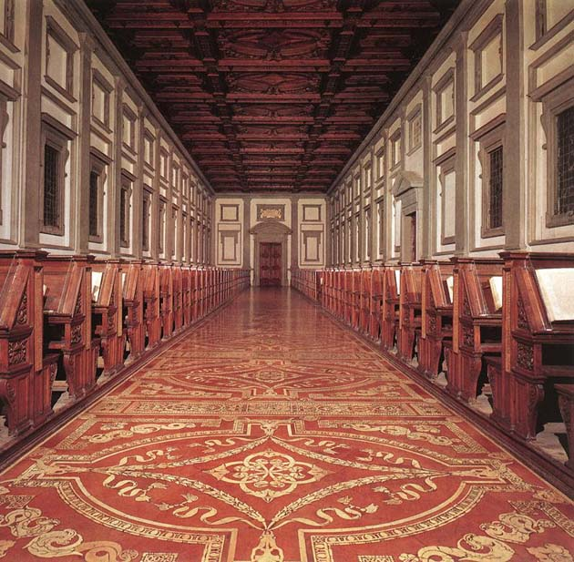
Medici Library
Florence 1523
Michelangelo
Page 46

Slide 46
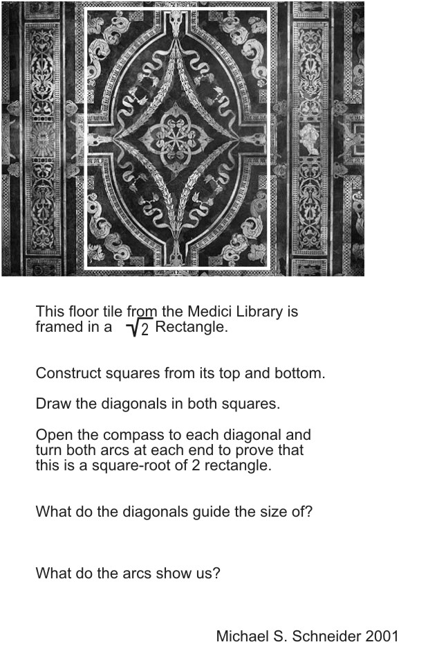
Page 61
white
Draw

Slide 47
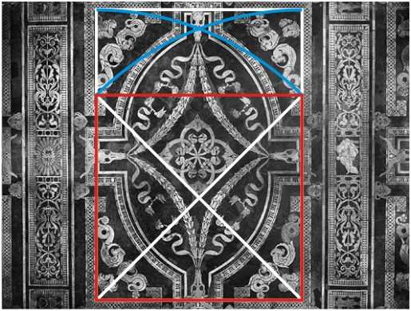
Page 61
A square is drawn from the bottom,
with white diagonals.
Blue arcs confirm that it’s a Root-2 Rectangle.

Slide 48
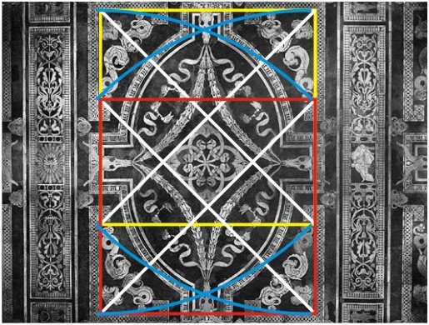
Page 61
Another yellow square is drawn from the top.
Its white diagonals frame the central design.
Other elements come from this framework.

Slide 49
